Slide 1
Unit -6
Sequential Circuit
Latch
Flip-Flop
Racing Error in FF
Flip-Flop Conversion

Slide 2
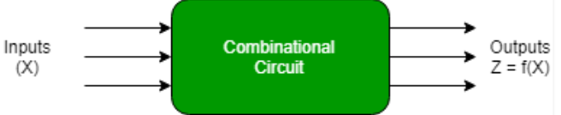
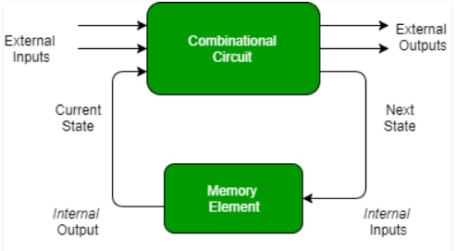
Combinational Circuit
Sequential Circuit
Output depends on only Present input | Output depends on present input as well previous value
Do not requires memory | Require memory to store previous value
Do not required Feedback | Require feedback
Faster | Slower
Easy to Design | Difficult to Design
Basic block are logic gate | Basic block are flip flop
Example - Adder, Decoder, Multiplexer | Example - Flip Flop, Counters, Shift register

Slide 3
Latch
Has two stable states (High-low)
Has feedback path
Latches can be memory devices,
Store one bit of data for as long as the device is powered
A asynchronous device

Slide 4
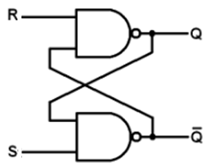
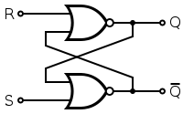
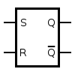
SR latch
SR latch (Set/Reset)
can be created with two NOR/NAND gates have a cross-feedback loop
S | R | Q | Q
0 | 0 | Invalid
0 | 1 | 0 | 1
1 | 0 | 1 | 0
1 | 1 | No Change
S | R | Q | Q
0 | 0 | No Change
0 | 1 | 0 | 1
1 | 0 | 1 | 0
1 | 1 | Invalid

Slide 5
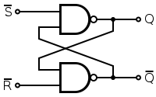
To maintain Uniformity
Input and swapped and Negated
S | R | Q | Q
0 | 0 | No Change
0 | 1 | 0 | 1
1 | 0 | 1 | 0
1 | 1 | Invalid

Slide 6
QUIZ
SR Latch comprised
Universal Gate
Equivalence Gate
Exclusive Gate
NOT Gate

Slide 7
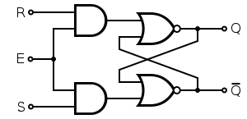
Gated SR latch
Gated SR latch is a simple extension of the SR latch
An Enable line must active before data can be latched
Operate as SR latch if E=1
Enable | S | R | Q | Q
0 | X | X | No Change
1 | 0 | 0 | No Change
1 | 0 | 1 | 0 | 1
1 | 1 | 0 | 1 | 0
1 | 1 | 1 | Invalid
If a clock is supplied as enable
Gated SR latch becomes known as an SR flip flop
Output changes only with nature of clock
Active Level Trigger → Latch
Active Edge Trigger → Flip Flop

Slide 8
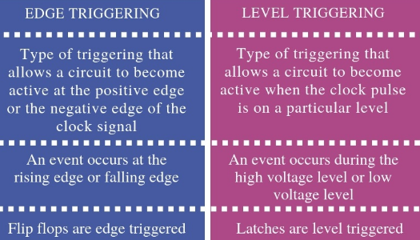


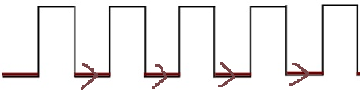

Latch vs Flip Flop
Clock Trigger - Triggering means making a circuit active
Positive Edge (0-1) Trigger
Positive Level (1-1) Trigger
Negative Edge (1-0) Trigger
Negative Level (0-0) Trigger

Slide 9
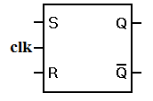
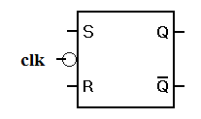
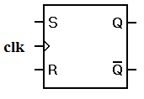
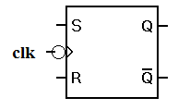
LATCH | FLIP-FLOP
A Latch is a level triggered device. | Flip-flop is an edge triggered device.
Latches are constructed from logic gates. | Flip-Flop is constructed from latches along with an additional logic gate
Latches are faster | Flip-Flops are slower
Less power is consumption | More power is consumption
The latches can be clocked or clockless. | For all the time, Flip-Flops are clocked.
The latch is asynchronous | Flip-Flop is synchronous
+ve Latch -ve Latch +ve FF -ve FF

Slide 10
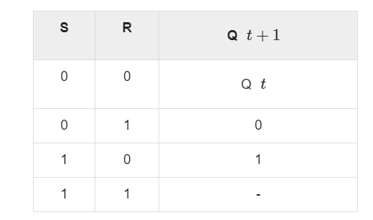
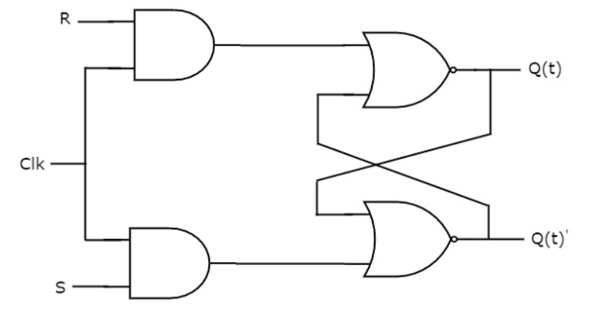
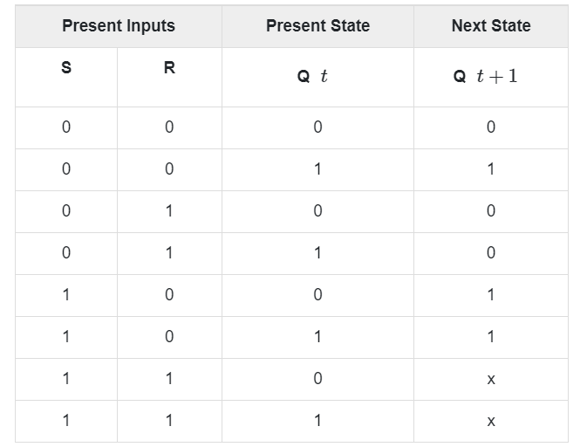
SR Flip Flop

Slide 11
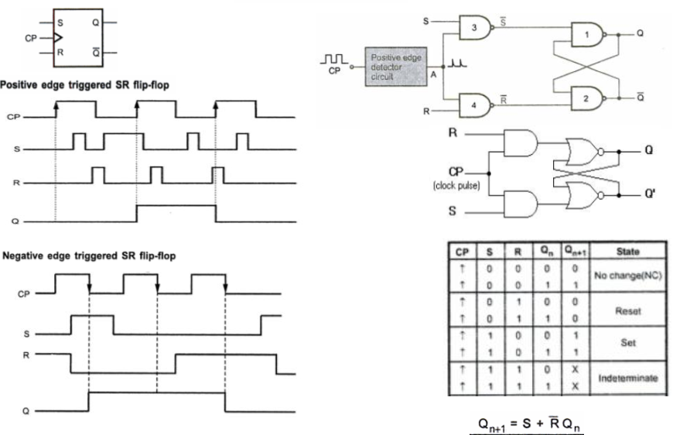
SR Flip Flop

Slide 12
Quiz
SR FF produces invalid output for SR input
00
01
10
11

Slide 13
QUIZ
Limitation of SR Flip Flop is it produces output
No Change
Reset
Set
Inhibit/Indeterminate/Invalid/Don’t Care

Slide 14
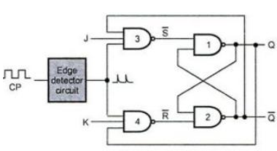
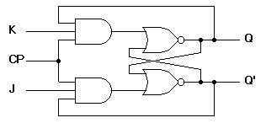
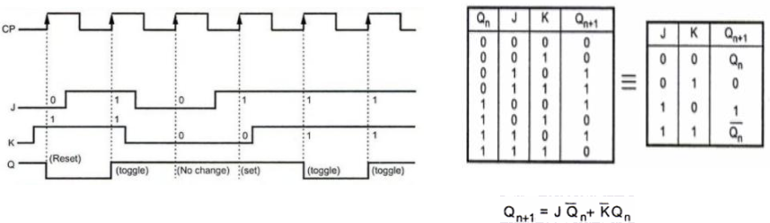
JK Flip Flop
J➔ Set
K➔ Reset
Limitation of SR-FF overcome in JK-FF by 3-input gate and additional feedback
JK-FF toggle (Complement) for input (JK=11)

Slide 15
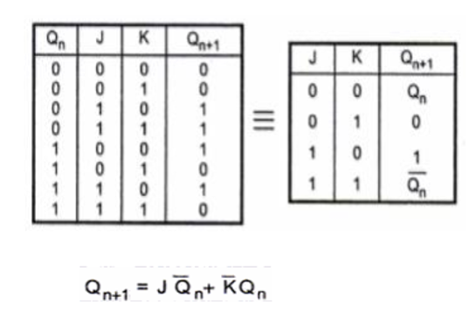
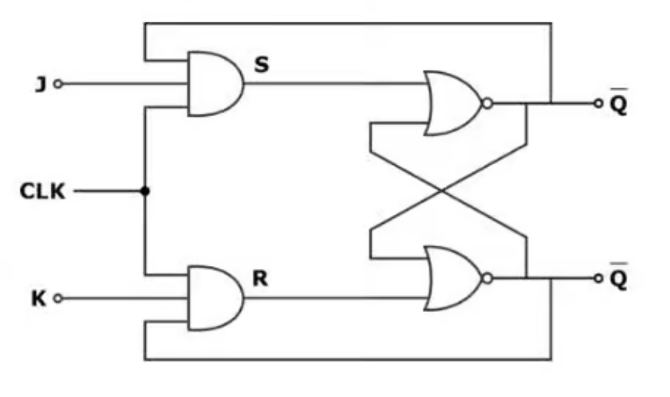

Slide 16
JK FF will Toggle when
J=0 K=0
J=0 K=1
J=1 K=0
J=1 K=1

Slide 17
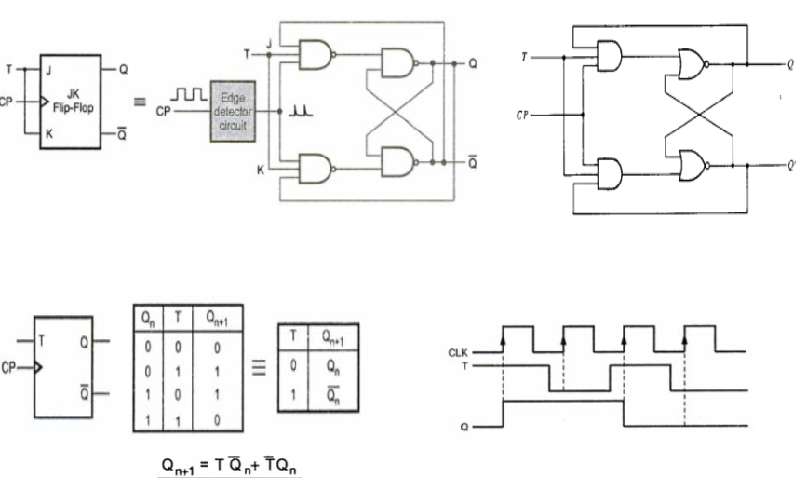
T Flip Flop
By Shorting J and K input, JKFF converted to TFF
Single input T
FF toggles (compliment) for T=1 and No Change for T=0
Truth Table resemble to XOR gate

Slide 18
Quiz
JK-FF can converts to T-FF
By inverting JK input
By shorting JK input
By connecting JK input to supply
By connecting JK input to ground

Slide 19
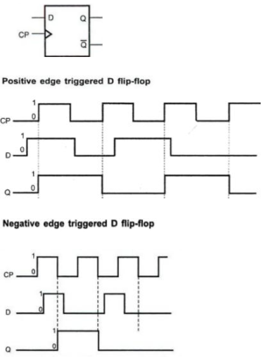
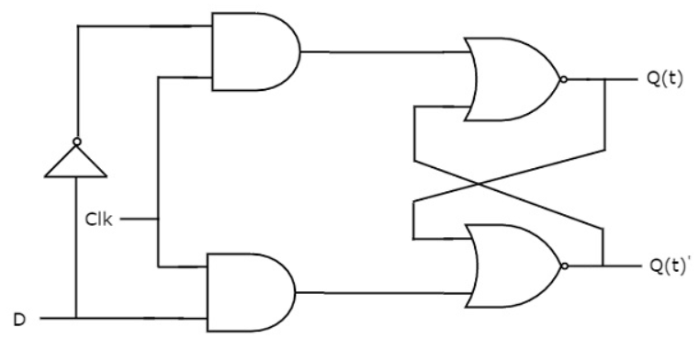
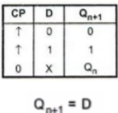
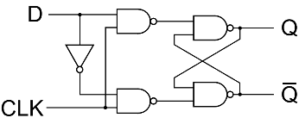
D Flip Flop
By inserting a NOT gate between J and K input, JKFF converted to DFF
By inserting a NOT gate between S and R input, SEFF converted to DFF
Single input D
Known as Delay/Data/Transparent FF
Truth Table resemble to XOR gate

Slide 20
Quiz
A _____ gate between J and K input, converts JK-FF to D-FF
BUF
NOR
NOT
OR

Slide 21
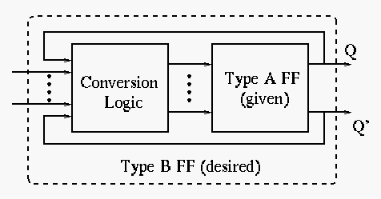
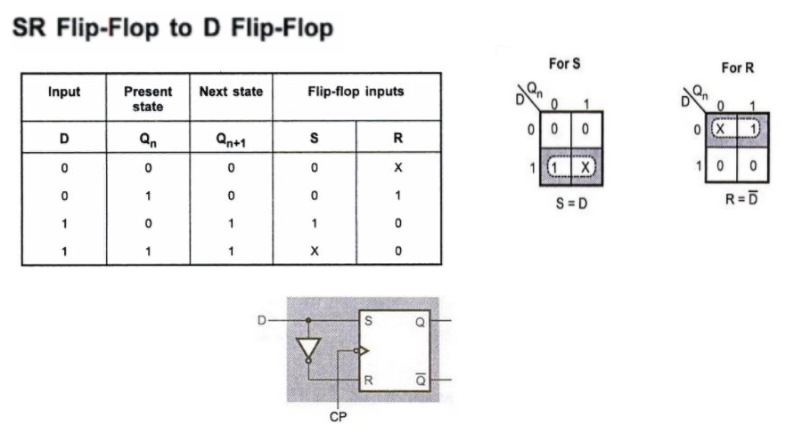
FF-Conversion
A FF can converted into other FF by some conversion logic
Based on FF excitation table
Steps
Write Truth table of desired FF
Write Excitation table of given FF based on state from step1
Derive FF input using KMAP based on input and present state of step1
SR to others Flip Flop Conversion

Slide 22
Excitation Table
Produce input if present and next state known
Derived from truth table
SR-FF Truth Table SR-FF Excitation Table
JK-FF Truth Table JK-FF Excitation Table
S | R | Qt | Qt+1
0 | 0 | 0 | 0
0 | 0 | 1 | 1
0 | 1 | 0 | 0
0 | 1 | 1 | 0
1 | 0 | 0 | 1
1 | 0 | 1 | 1
1 | 1 | 0 | X
1 | 1 | 1 | X
J | K | Qt | Qt+1
0 | 0 | 0 | 0
0 | 0 | 1 | 1
0 | 1 | 0 | 0
0 | 1 | 1 | 0
1 | 0 | 0 | 1
1 | 0 | 1 | 1
1 | 1 | 0 | 1
1 | 1 | 1 | 0
Qt | Qt+1 | S | R
0 | 0 | 0 | X
0 | 1 | 1 | 0
1 | 0 | 0 | 1
1 | 1 | X | 0
Qt | Qt+1 | J | K
0 | 0 | 0 | X
0 | 1 | 1 | X
1 | 0 | X | 1
1 | 1 | X | 0

Slide 23
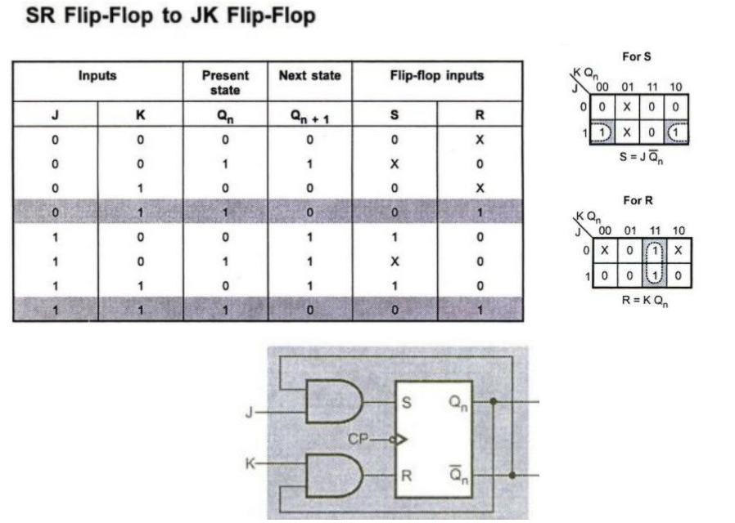
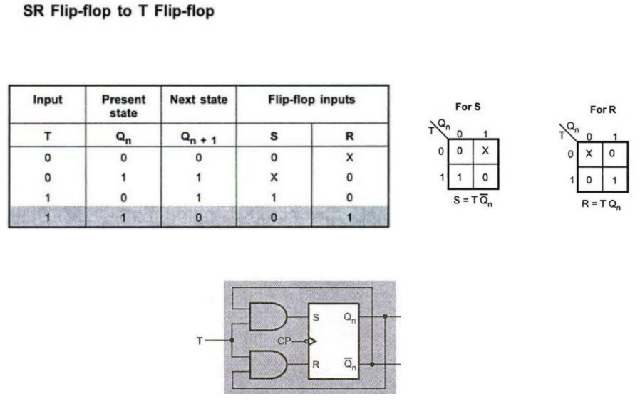

Slide 24
T-FF Truth Table T-FF Excitation Table
D-FF Truth Table D-FF Excitation Table
T | Qt | Qt+1
0 | 0 | 0
0 | 1 | 1
1 | 0 | 1
1 | 1 | 0
Qt | Qt+1 | T
0 | 0 | 0
0 | 1 | 1
1 | 0 | 1
1 | 1 | 0
D | Qt | Qt+1
0 | 0 | 0
0 | 1 | 0
1 | 0 | 1
1 | 1 | 1
Qt | Qt+1 | D
0 | 0 | 0
0 | 1 | 1
1 | 0 | 0
1 | 1 | 1
Present State | Next State | SRFF |  | JKFF |  | TFF | DFF
Qt | Qt+1 | S | R | J | K | T | D
0 | 0 | 0 | X | 0 | X | 0 | 0
0 | 1 | 1 | 0 | 1 | X | 1 | 1
1 | 0 | 0 | 1 | X | 1 | 1 | 0
1 | 1 | X | 0 | X | 0 | 0 | 1

Slide 25
Quiz
A table provides input based on states is called
Truth table
Excitation table
State table
Clock table

Slide 26
In J-K flip-flop, the function K=J is used to realize _____________
a) D flip-flop
b) S-R flip-flop
c) T flip-flop
d) S-K flip-flop

Slide 27
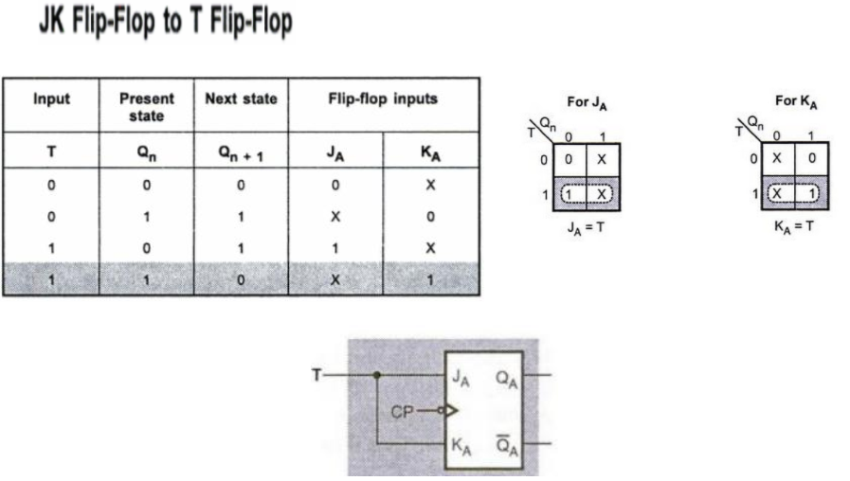
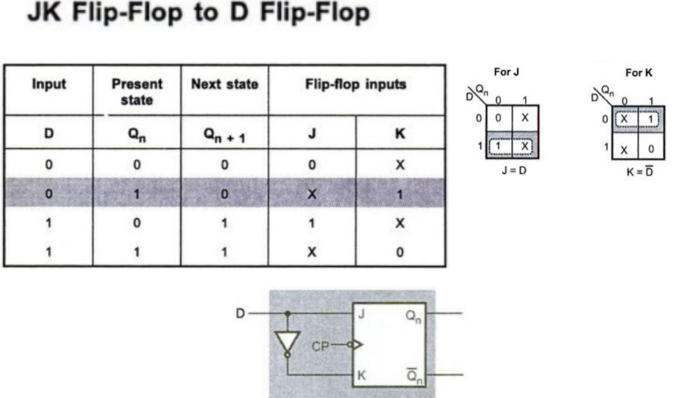
JK to Others Flip Flop Conversion

Slide 28
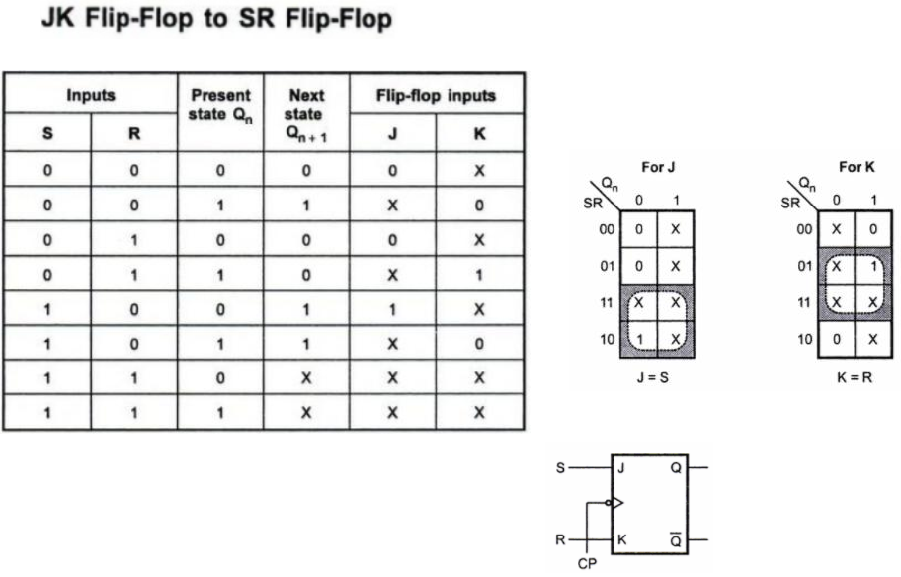

Slide 29
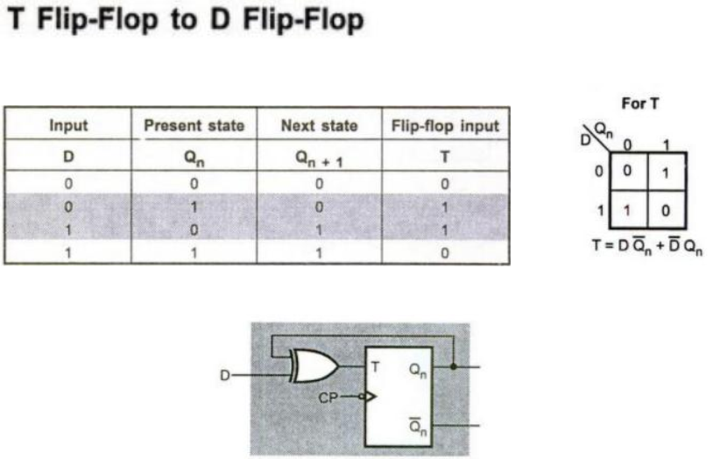
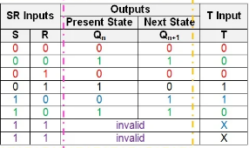
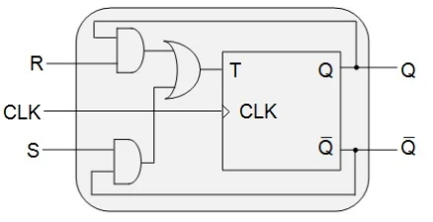
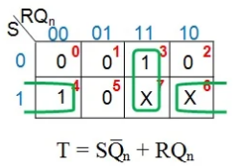
T to Others Flip Flop Conversion
T to SR Conversion

Slide 30
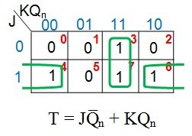
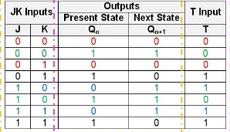
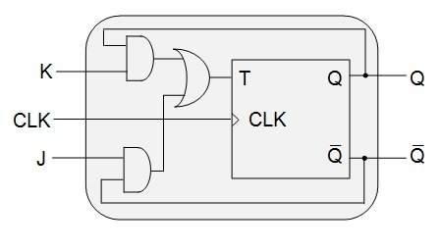
T to JK Conversion

Slide 31
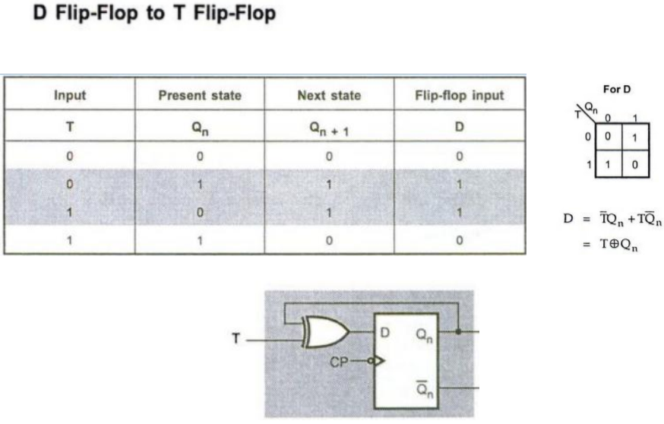
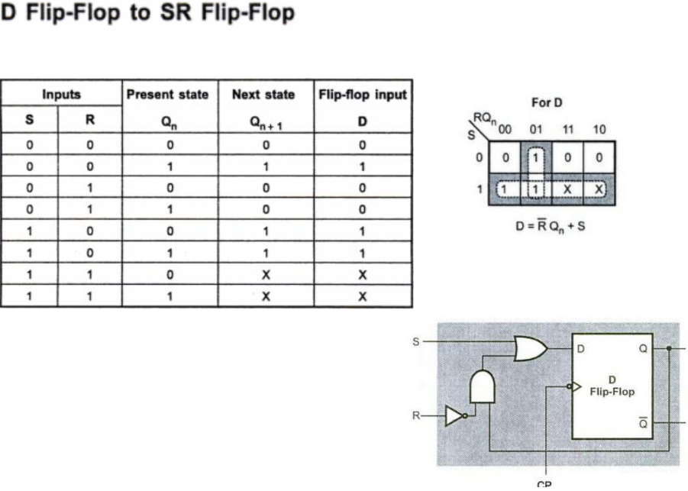
D to others Flip Flop Conversion

Slide 32
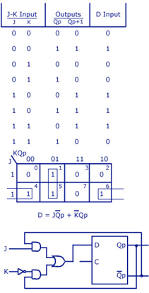
D to JK conversion

Slide 33
In delay flip-flop, _______ after the propagation delay
a. Input follows input
b. Input follows output
c. Output follows input
d. Output follows output

Slide 34
D Latch vs D Flip Flop
Clock level sensitive
Q=D when clock level is enabled
In one level more than one data can transferred
Clock edge sensitive
Q=D when clock edge is enabled
Only one data can transferred

Slide 35
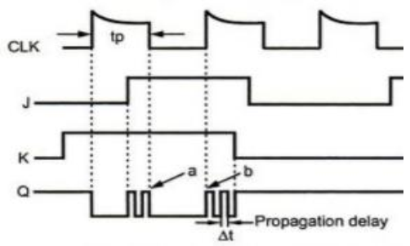
Race around condition/Racing Error in JK
Racing error exist when
Δt ≤ tp
To avoid Racing error
Δt > tp
J=K=1, and clk=1 for a long period of time
Q output will toggle as long as CLK is high (active)
Toggling will be continue till J=K=1 and clk active
The output of the flip-flop unstable or uncertain
Racing eliminated by
Master Slave JK FF (MS-JK FF)
Edge triggered FF

Slide 36
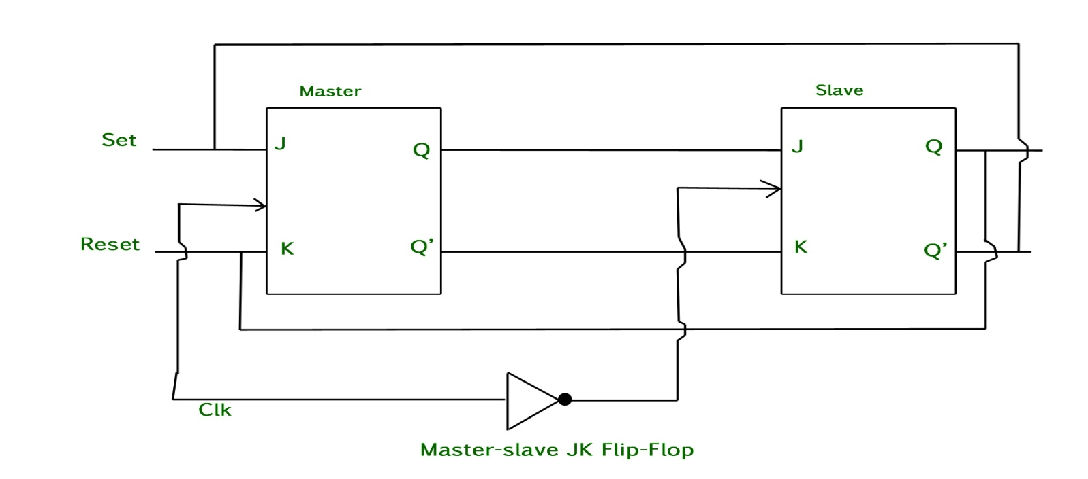
Master Slave JK FF
Two JK flip-flops connected together in a series.
First is master and second slave
The output from the master flip flop acts as inputs of the slave flip flop, whose output is fed back to inputs of the master flip flop.
A inverter (NOT) is connected to clock pulse
Master and slave enable on opposite level of clock
CP=0 master enable CP=1 slave enable
CP=1 master enable CP=0 slave enable
Limitation – Requires additional JK FF and NOT gate
Edge triggered FF preferred, since FF enable once in a clock period

Slide 37
QUIZ
Race around condition in can avoid by
Master slave JK flip flop
Edge triggered clock
Either (A) or (B)
Neither (A) nor (B)

